Slide 1

Exploring Predictive Factors for Depression Among Students
Tushar Sethi

Slide 2
Abstract
This project dives into understanding what factors contribute to student depression. By analyzing two datasets, we explored the relationships between academic performance, social environment, and personal circumstances. Using data analytics, the goal was to uncover meaningful patterns that could help identify students at risk and suggest ways to support them better

Slide 3
Problem Statement
Student depression is a growing issue that affects academic performance and overall happiness. If we can figure out what leads to depression, educators and policymakers can create better strategies to help

Slide 4
The Data
The project uses two datasets:
Student Mental Health Dataset: Focuses on mental health aspects like Depression, Anxiety, etc.
Student Academic Performance Dataset: Focuses on academic and social factors like Peer Influence, Parental Involvement, etc.
Preprocessing Steps:
Handled Missing Values
Refactored Column Names
Standardized Formatting

Slide 5
Exploratory Data Analysis
Boolean Features: Confusion matrices helped show how depression relates to Marital Status, Extracurricular Activities, etc.
Categorical Features: Count plots highlighted patterns in factors like parental involvement and motivation level. Students with low parental involvement showed higher rates of depression.
Numerical Features: Histograms revealed how numeric features, like Hours Studied and Attendance, differed between students with and without depression.

Slide 6
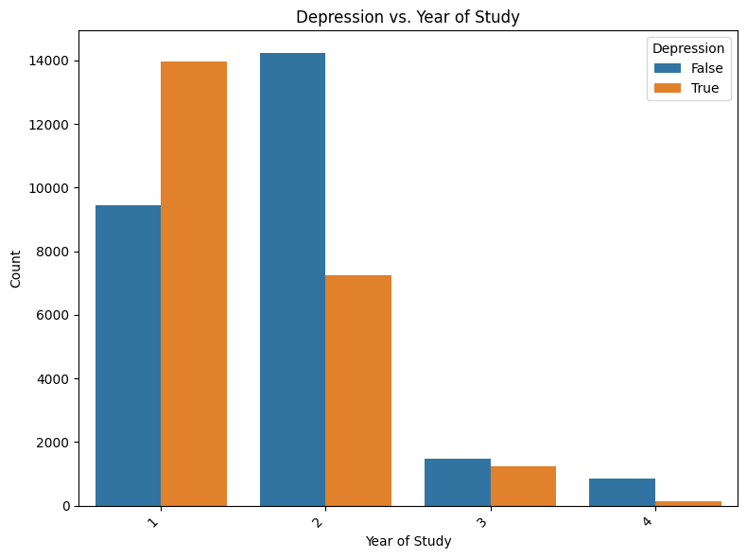
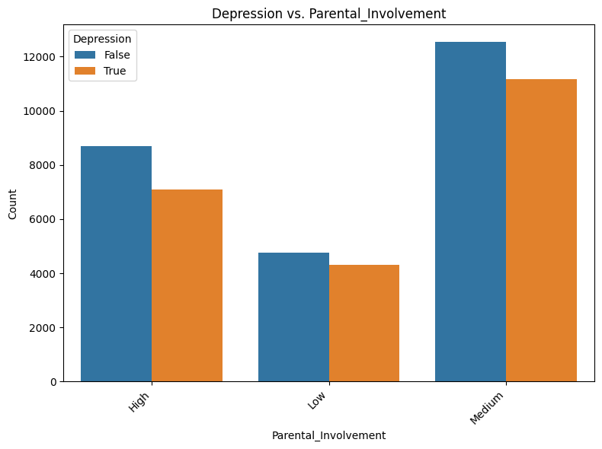
Findings

Slide 7
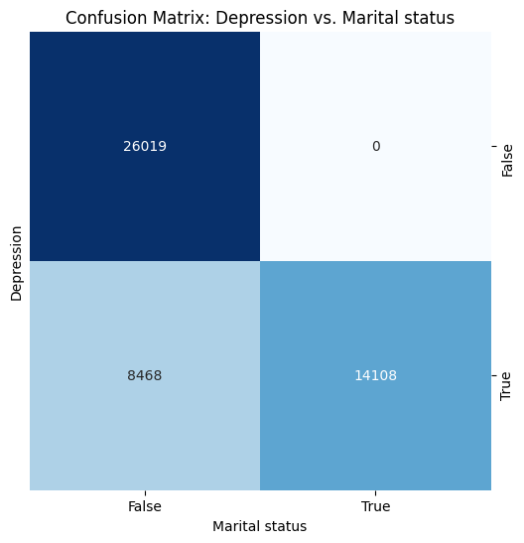
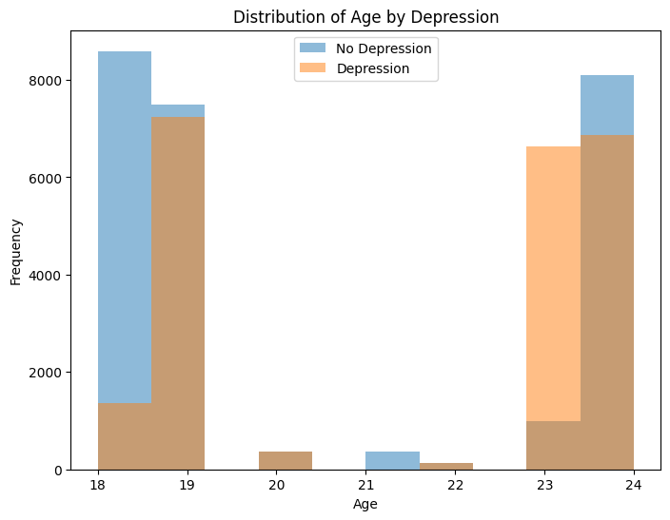
Unique Findings

Slide 8
Shortlisted Columns
Depression, Marital_Status, Parental_Involvement, Access_to_Resources, Year_of_Study, Teacher_Quality, Peer_Influence and Age

Slide 9
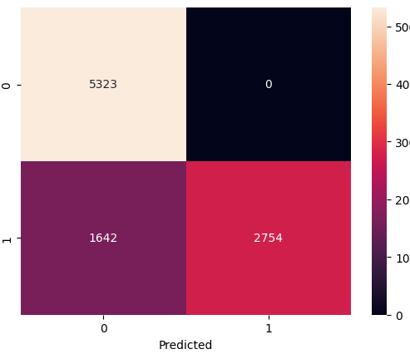
Logistic Regression
Accuracy: 0.83
F1 Score: 0.77

Slide 10
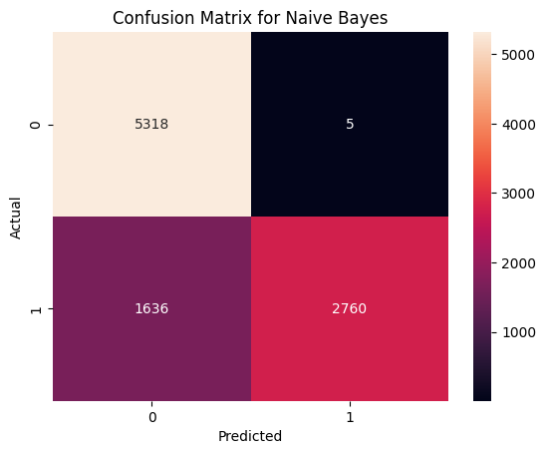
Naïve Bayes
Accuracy: 0.83
F1 Score: 0.77

Slide 11
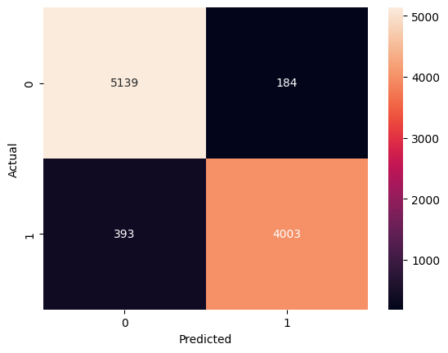
Random Forest
Accuracy: 0.94
F1 Score: 0.93

Slide 12
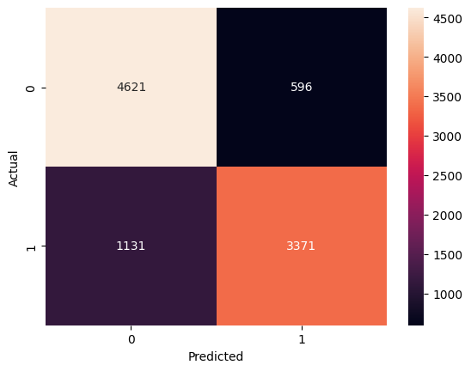
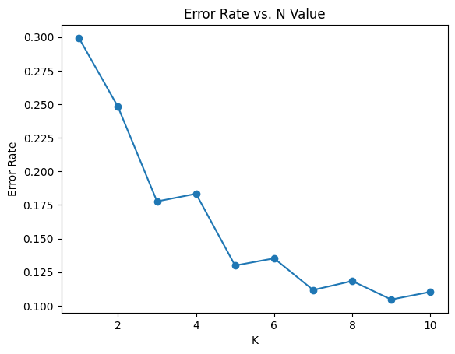
KNN
Accuracy: 0.94, F1 Score: 0.93

Slide 13
Future Work
Expand the Dataset: The current dataset focuses on one region. Expanding it to include students from other regions or countries would make the findings more universal.
Better Validation: Instead of relying on general surveys, using more detailed and validated psychological questionnaires would improve the accuracy of the data.
Dive Deeper: Anxiety and panic attacks are also part of the dataset. By clustering the data, we could identify what factors lead to different mental health issues.

Slide 14
Conclusion
This analysis shows that focusing on factors like parental involvement, peer influence, and access to resources could help prevent depression in students. By addressing these areas, we can create better support systems and a healthier environment for future students

